Slide 1
Cerner SMART FHIR

Slide 2
Growth Chart by Cerner

Slide 3
SMART Growth Chart by Boston Children’s

Slide 4
SMART Growth Chart by Boston Children’s

Slide 5
Recommendation to Developer
Where to start?
Cerner code(Cerner Millennium - EHR apps) https://code.cerner.com/
Cerner’s SMART on FHIR Homepage: http://fhir.cerner.com/
Cerner’s Ignite Learning Lab (peruse all folders): https://github.com/cerner/ignite-learning-lab
Cerner’s SMART on FHIR Tutorial: http://engineering.cerner.com/smart-on-fhir-tutorial/
HL7 FHIR: http://hl7.org/fhir/, http://hl7.org/fhir/DSTU2/
SMART: https://smarthealthit.org/
Google Developer Group
https://groups.google.com/forum/#!forum/cerner-fhir-developers
Marketplace SMART FHIR Apps
https://code.cerner.com/apps

Slide 6
Recommendation to Developer
Starter code
https://smarthealthit.org/build-apps/
http://docs.smarthealthit.org/clients/javascript/
https://github.com/smart-on-fhir/client-js
Cerner Sandbox
https://code.cerner.com/developer/smart-on-fhir/apps
Allows the developer to run SMART apps using localhost
Limited patient data
Stability is improving (was down a lot at first)
Lessons Learned
You may/may not be able to filter on your desired criteria. So, you have to retrieve a superset of the data, and then filter using custom code. Not the greatest for performance.
FHIR client always passes FHIR Patient ID
Does not support multiple concurrent browser sessions
Cerner does not support server-side sorting

Slide 7
Authorization Process
SMART apps in Cerner(see slides)
Contextless apps
http://fhir.cerner.com/authorization/authorization-specification/#contextless-flow

Slide 8
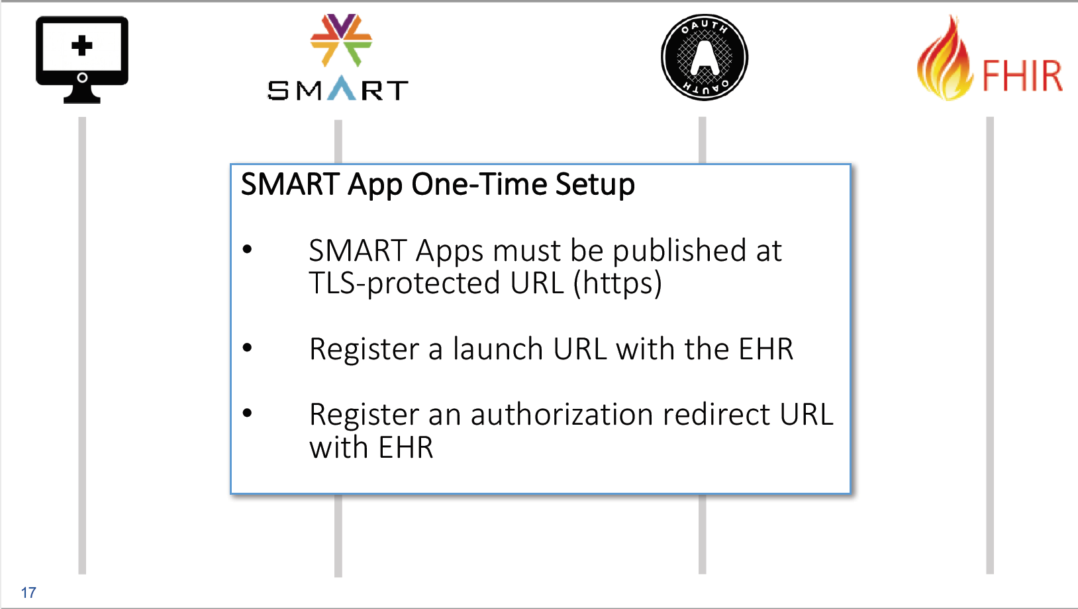

Slide 9
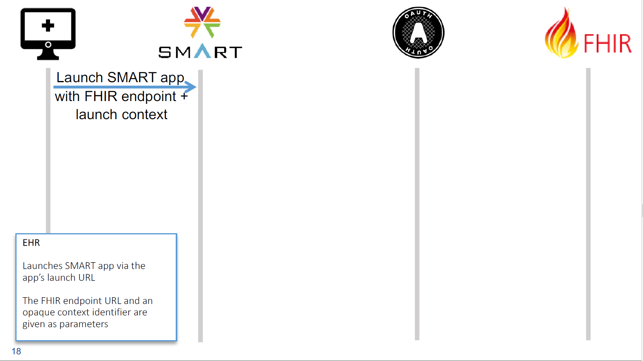

Slide 10
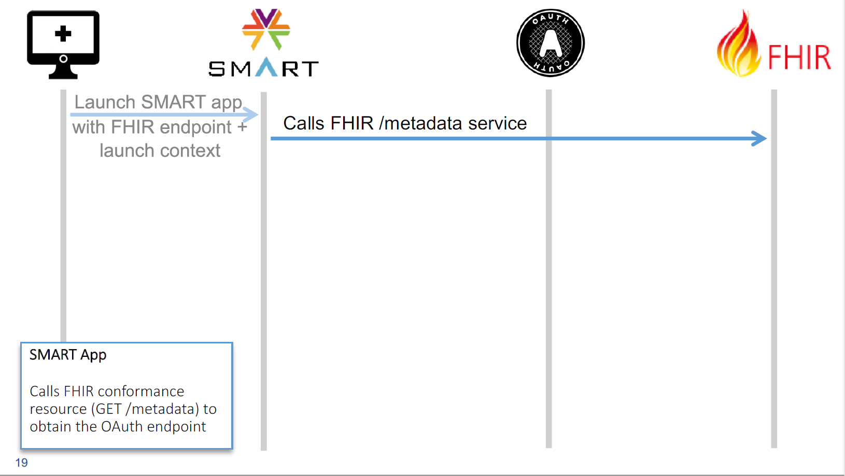

Slide 11
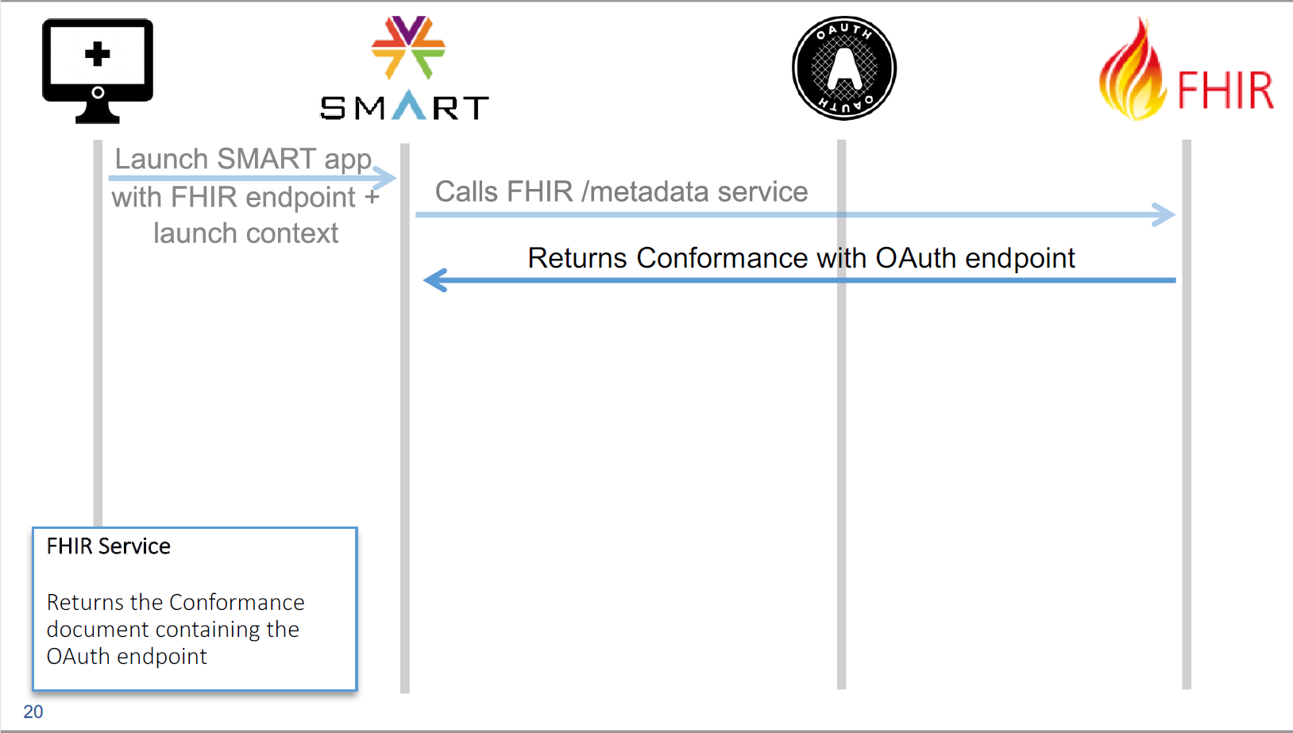

Slide 12
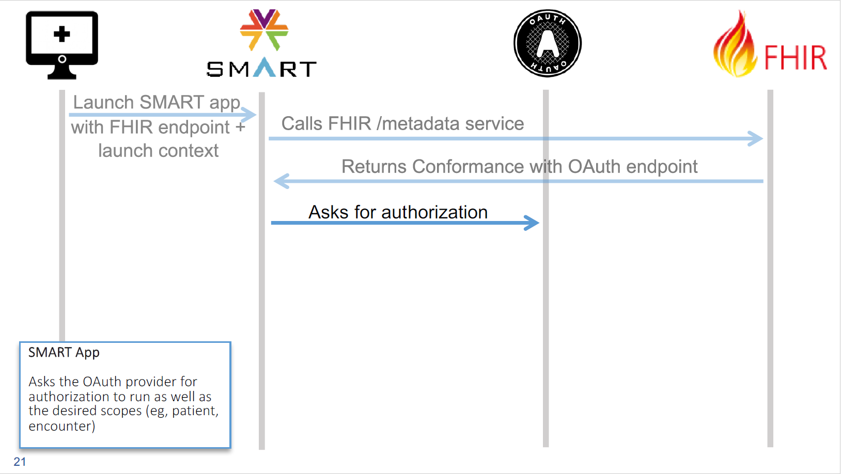

Slide 13
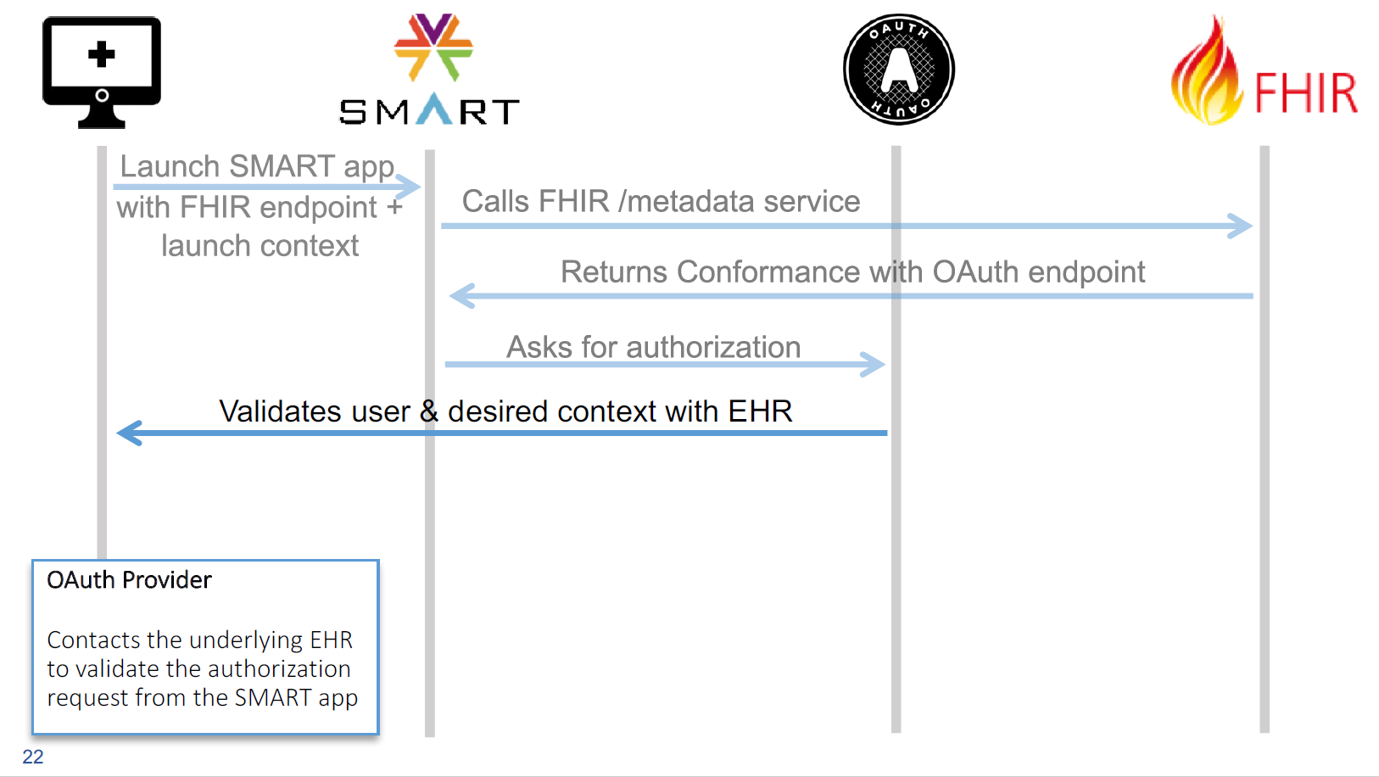

Slide 14
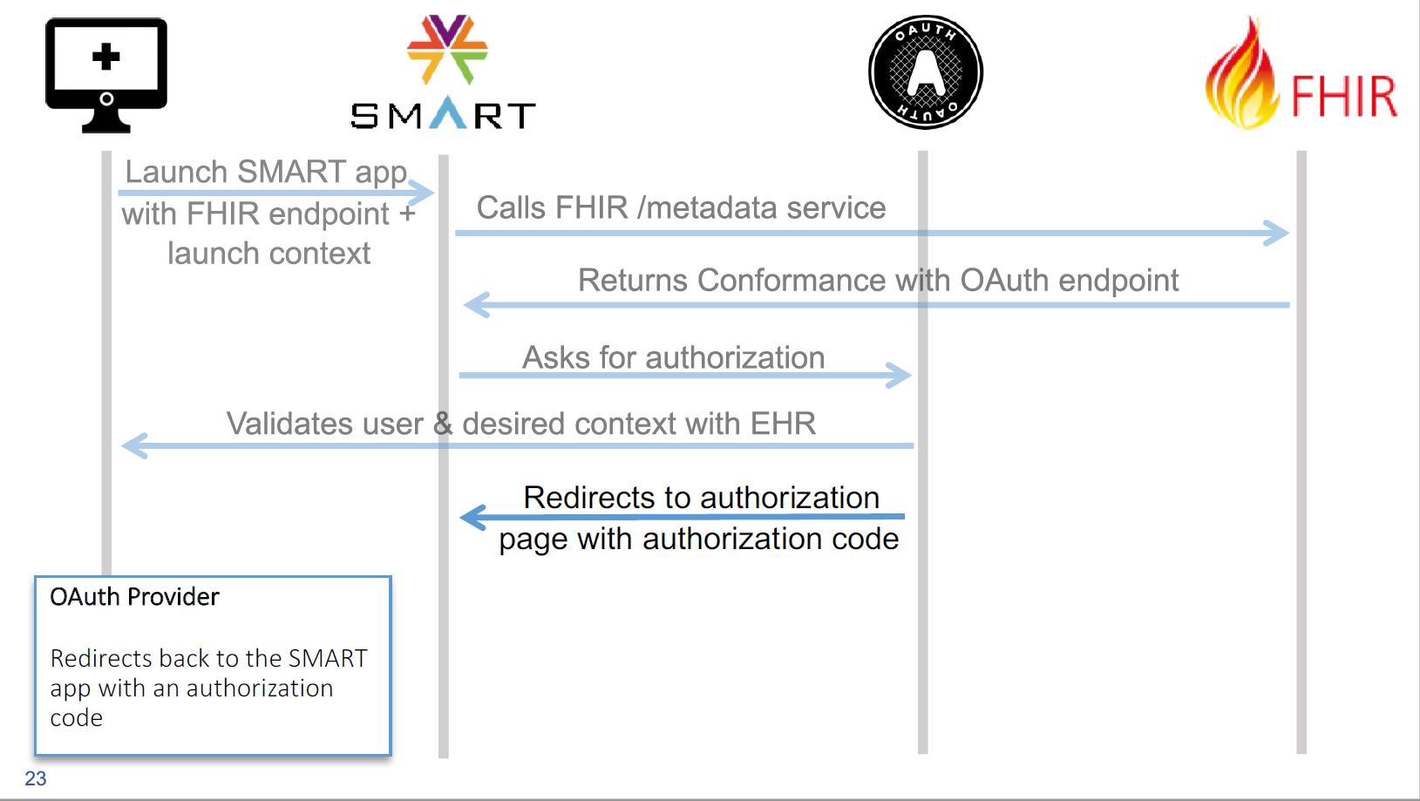

Slide 15
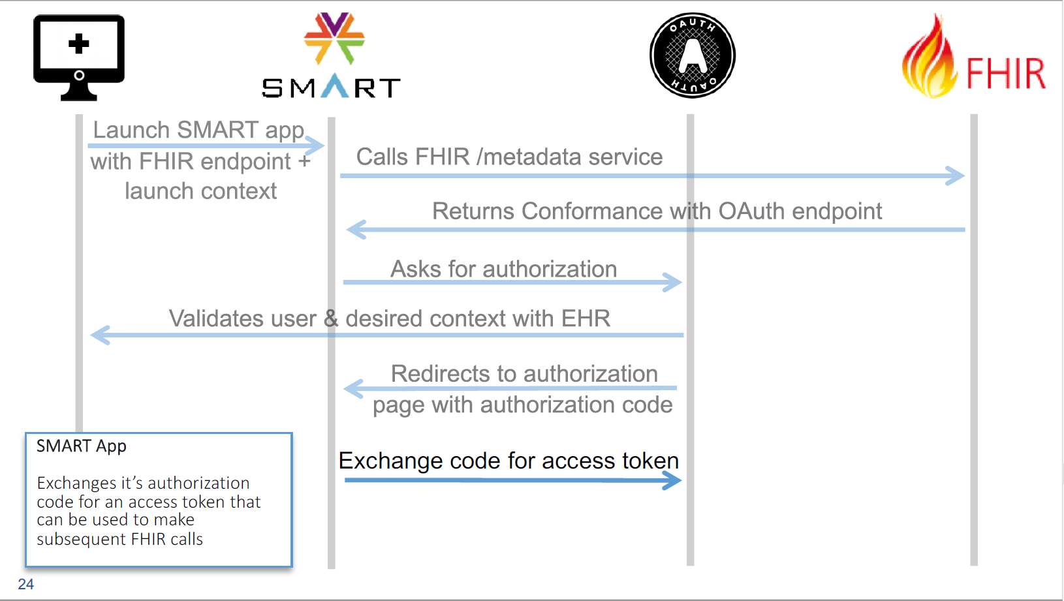

Slide 16
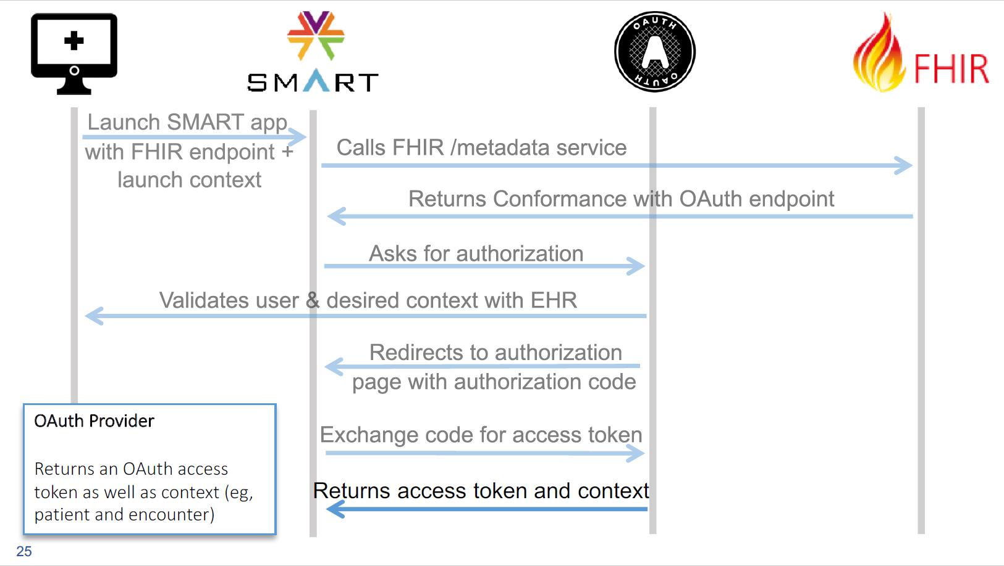

Slide 17
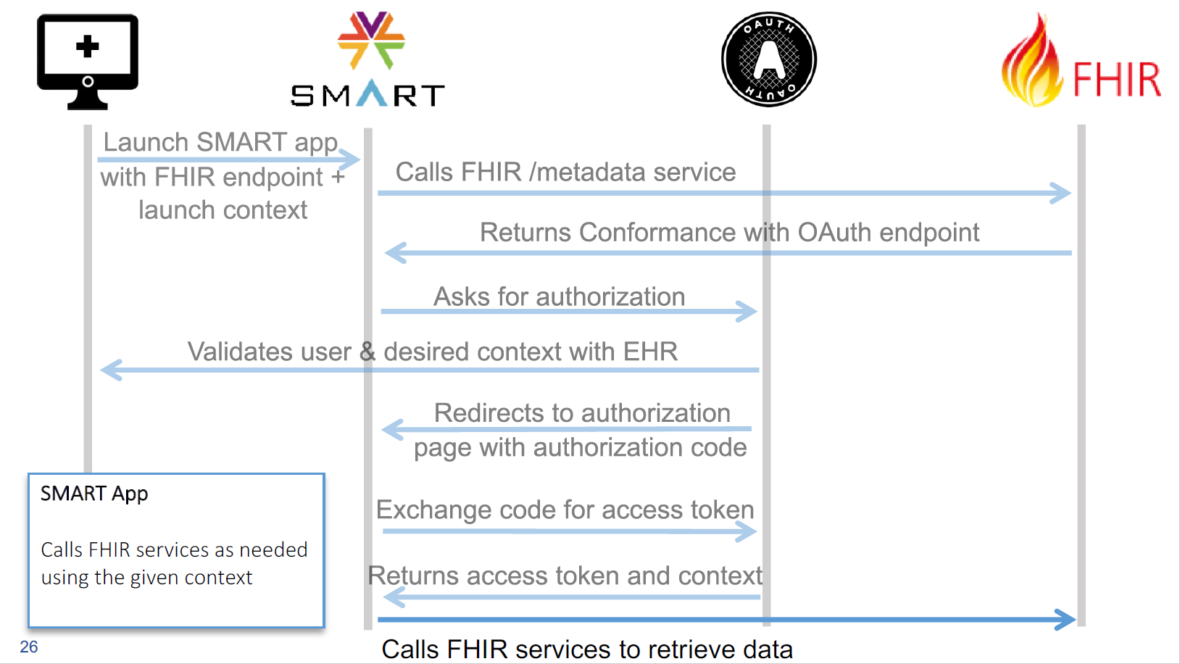

Slide 18
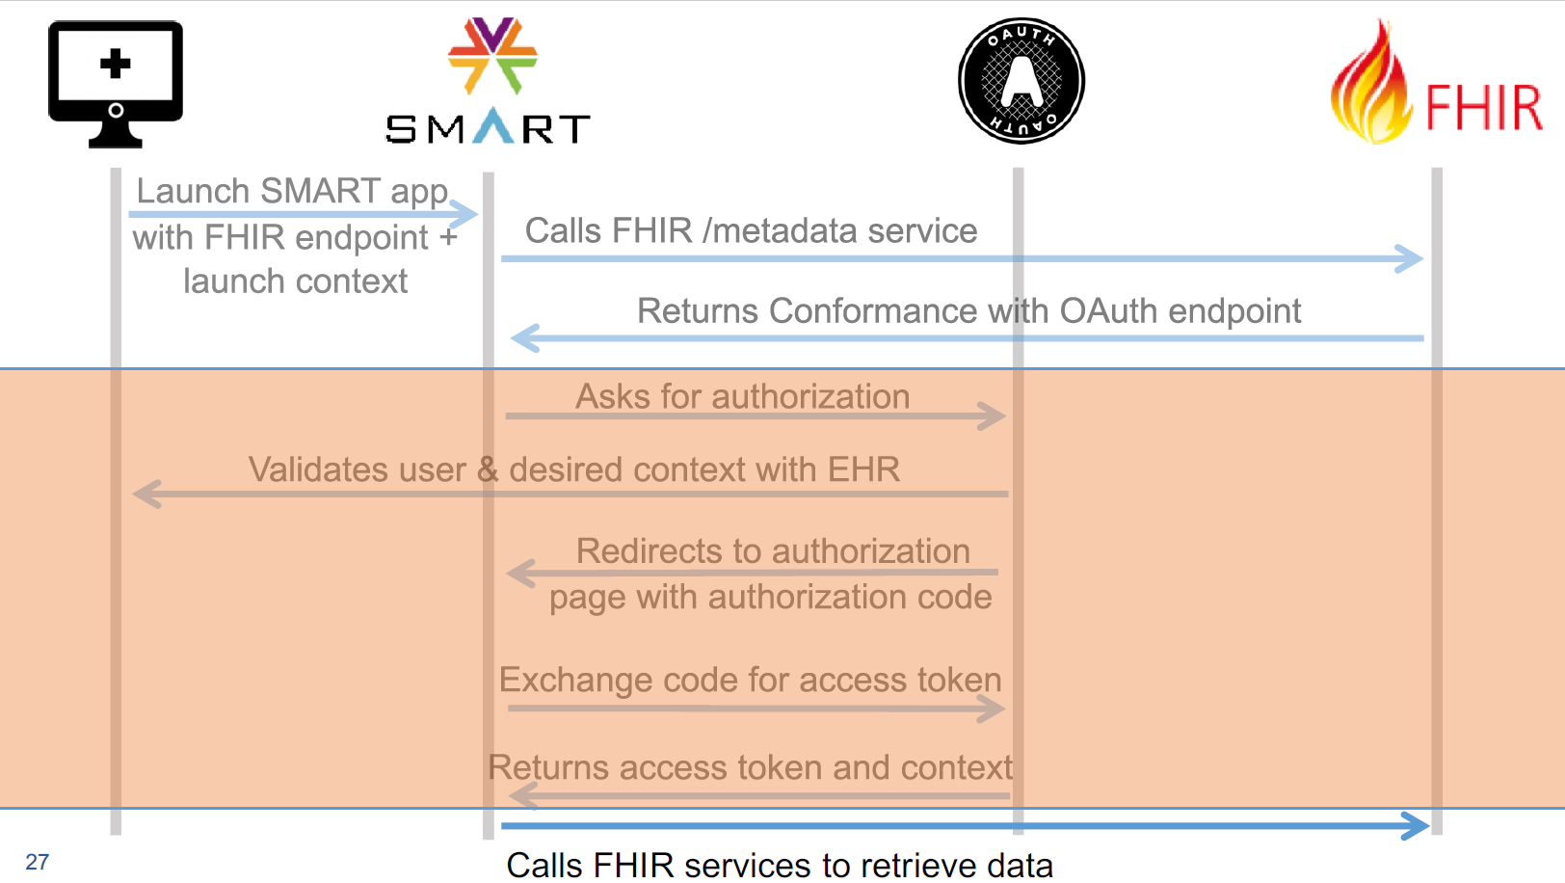

Slide 19
SMART Apps in Cerner
Two ways to launch a SMART FHIR App in Cerner
Table of Contents band
Extra click for clinician to get to. Another click to get back to where they were
In the Workflow mpage
Embedded in view
Need JS library (http://engineering.cerner.com/smart-on-fhir-tutorial/#mpages-integration)

Slide 20
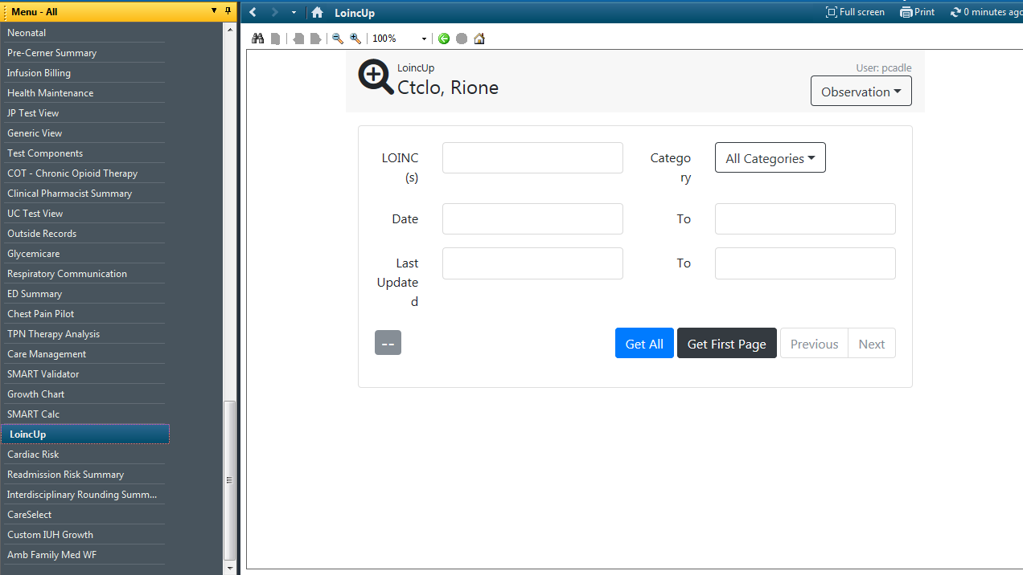
Table of Contents Band

Slide 21
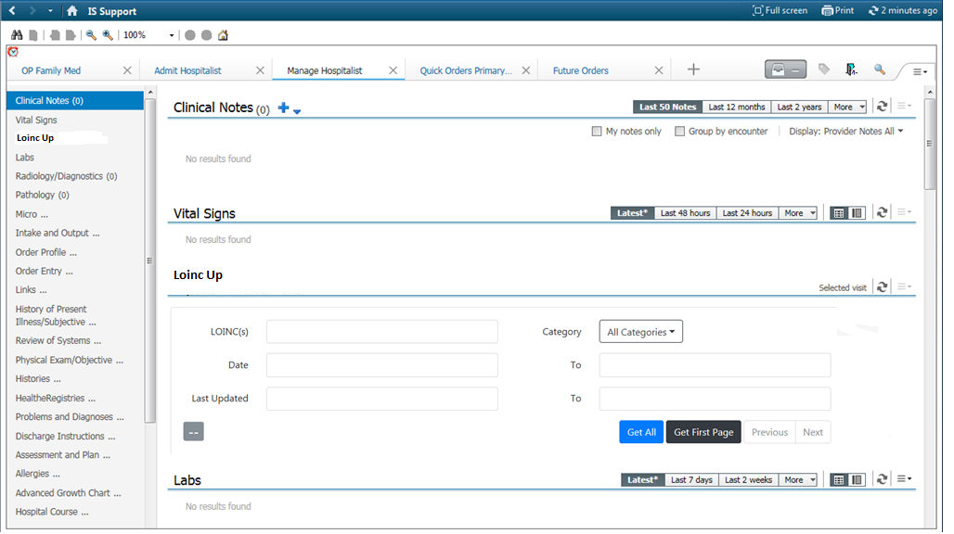
Workflow Mpage

Slide 22
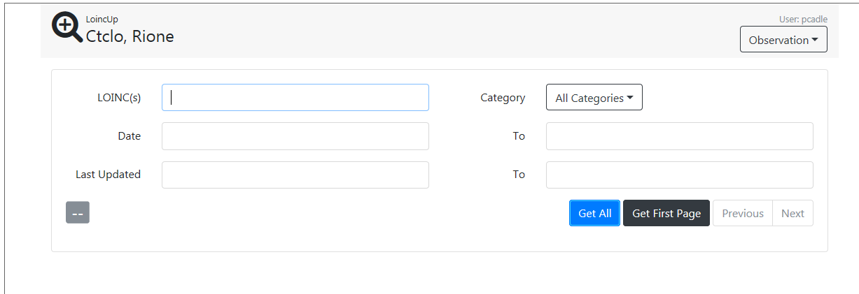
Developed Apps
LOINC Up
Developed app to test SMART authorization and FHIR resource calls. This is useful today to validate Cerner code mappings vs. what is charted.
Technology stack includes: .Net Core, Entity Framework Core, SQL Server, Angular 2.0, Type Script and FHIR open source java library
FHIR Resources:Observation, Condition, Diagnostic Report

Slide 23
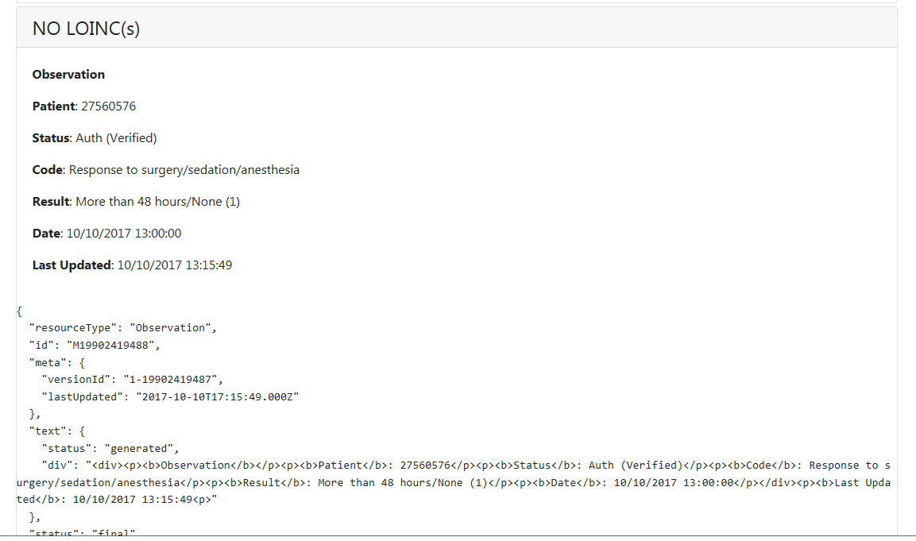
Developed Apps

Slide 24
Questions

